Slide 1
BA Training Day 1

Slide 2

Introduction
Overview of training
What is a Project?
What is a Process?
Project Management
Project Life Cycle

Slide 3

What Is a Project?
A project is an activity to meet the creation of a unique product or service.
Example: Arranging a Birthday Party
Online Airline Ticketing System

Slide 4

What Is a Process?
A process is a series of steps and decisions involved in the way work is completed.
Example:
Send invitation
Plan theme
Book venue
Order cake

Slide 5
Difference between Process and Project
PROCESS | PROJECT
A “process” has an objective that is typically defined around the ongoing operation of the process. For example, “provide ongoing maintenance for GM vehicles” | A “project” has an objective or outcome to be accomplished and the project ends when that objective is accomplished. That objective might be broadly-defined and might change or be further elaborated as the project is in progress. For example, “find a replacement ignition switch that will solve the problem with GM vehicles".
A “process” is generally ongoing and doesn’t normally have an end. | A “project” has a beginning and an end (although the beginning and end may not be well-defined when the project starts and the end might be a long time in the future).
A “process” is a repetitive sequence of tasks and the tasks are known at the outset since it is repetitive. | The sequence of tasks in a “project” is not normally repetitive and may not be known at the outset of the project.

Slide 6
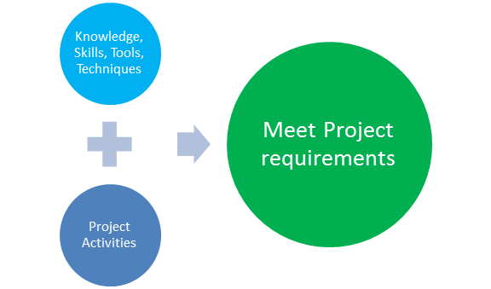
What is Project Management?
Project management is the application of knowledge, skills, tools, and techniques to project activities to meet the project requirements.

Slide 7
Difference between Process and Project Management
PROCESS MANAGEMENT | PROJECT MANAGEMENT
Process management is focused on managing a process such as a software development process. Such a process might be used across a variety of projects. Process management might involve some project management to define and improve the process. | Project management is focused on managing a project typically using some process in achieving some kind of desired end result. Every project follows some kind of process even though it may not be formally defined.
Process management has an emphasis on increasing "repeatability" of the tasks, improving efficiency (decreasing time needed, reducing cost), and improving quality of the work product produced by the process (including consistency in quality). | Project management has an emphasis on achieving the end result that the project is intended to accomplish. Higher efficiency is harder to achieve since it might require custom tools and methods that can only be developed if the project was turned into a repetitive process.

Slide 8
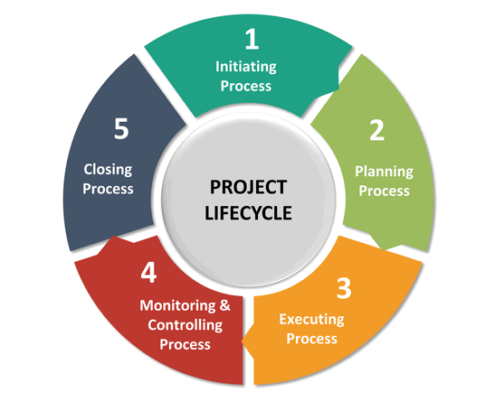
Project Life Cycle
Is a series of phases that represent the evolution of a product or service from concept through delivery, maturity, and to retirement.
The project life cycle refers to the five-step process that is followed by nearly all project managers when moving through stages of project completion.

Slide 9
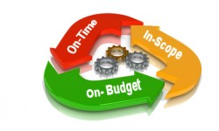
Project Initiation
Initiation is the first phase of the project lifecycle.
This is where the project’s value and feasibility are measured.
Project managers typically use two evaluation tools to decide whether or not to pursue a project:
Business Case Document – This document justifies the need for the project, and it includes an estimate of potential financial benefits.
Feasibility Study – This is an evaluation of the project’s goals, timeline and costs to determine if the project should be executed.

Slide 10
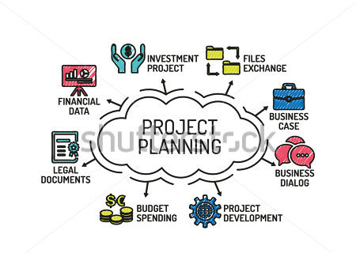
Project Planning
A well-written project plan gives guidance for obtaining resources, acquiring financing and procuring required materials.
The project plan gives the team direction for producing quality outputs, handling risk, creating acceptance, communicating benefits to stakeholders and managing suppliers.
The project plan also prepares teams for the obstacles they might encounter over the course of the project, and helps them understand the cost, scope and timeframe of the project.

Slide 11
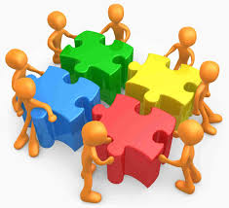
Project Execution
This is the phase that is most commonly associated with project management.
Execution is all about building deliverables that satisfy the customer.
Team leaders make this happen by allocating resources and keeping team members focused on their assigned tasks.
Execution relies heavily on the planning phase. The work and efforts of the team during the execution phase are derived from the project plan.

Slide 12

Project Monitoring & Control
Monitoring and control are sometimes combined with execution because they often occur at the same time.
As teams execute their project plan, they must constantly monitor their own progress.
To guarantee delivery of what was promised, teams must monitor tasks to prevent scope creep, calculate key performance indicators and track variations from allotted cost and time.
This constant vigilance helps keep the project moving ahead smoothly.

Slide 13

Project Closure
Teams close a project when they deliver the finished project to the customer, communicating completion to stakeholders and releasing resources to other projects.
This vital step in the project lifecycle allows the team to evaluate and document the project and move on the next one, using previous project mistakes and successes to build stronger processes and more successful teams.
Although project management may seem overwhelming at times, breaking it down into these five distinct cycles can help your team manage even the most complex projects and use time and resources more wisely.

Slide 14


